Slide 1


Slide 2


01CE1306- WEB TECHNOLOGY
Unit -1 Introduction to
Web and HTML
Prepared By: Prof. Charmy Vora

Slide 3

Course Outcome
CO1- Design and develop interactive web pages using HTML5, identifying the correct use of attributes, incorporating multimedia elements and form validations. (Apply)

Slide 4
Outlines
Introduction to Web Servers
HTTP request and Response Model
Structure of HTML
Doctypes in HTML
HTML Tags
Elements and attributes.
HTML 5
HTML 5 Layout and syntax
Attributes
Events
Web forms and validations
Audio & Video
SVG

Slide 5

Introduction
Basic Terminology of Internet and Web Servers
Internet:
A vast, global network of interconnected computer networks.
Enables communication and data exchange between devices worldwide.
Uses protocols like TCP/IP to manage data transmission.
Provides the foundation for many online services like email, web browsing, social media, online banking, gaming and many more.

Slide 6
Introduction
Web (World Wide Web):
A system of interconnected documents (webpages) and resources.
Accessed via the Internet using web browsers.
Uses protocols like HTTP to access and display information.
Features hyperlinks that allow users to navigate between different webpages.
Includes websites, images, videos, and other multimedia content.

Slide 7
Introduction
Web (World Wide Web) V/S Internet:
 | Web (World Wide Web) | Internet
Definition | A system of interlinked hypertext documents and multimedia content accessible via the Internet | A global system of interconnected computer networks
Founded | In 1989, Tim Berners-Lee | 1960s
Is it Service? | Yes | No. It is an infrastructure.
It uses | An HTTP/HTTPS | TCP/IP, FTS, SMTP, IMAP and many more.
Based on Hardware? | No. It’s more software-oriented. | Yes

Slide 8
Introduction
Web Page: A single page on the web (a "homepage" is the first web page on a web site)
Website : A collection of web pages.
Web Browser/Navigator/Client : The software application which displays web pages
Web Server : A computer and software that delivers web pages to users over the Internet (e.g., Apache, Nginx).
HTML (Hyper Text Markup Language) : The standard language for creating web pages.
HTTP/HTTPS (Hyper Text Transfer Protocol / Secure) : Protocols used to transfer web content. HTTPS includes encryption.
Uniform Resource Locator (URL) : The full web address used to access a specific page or file

Slide 9
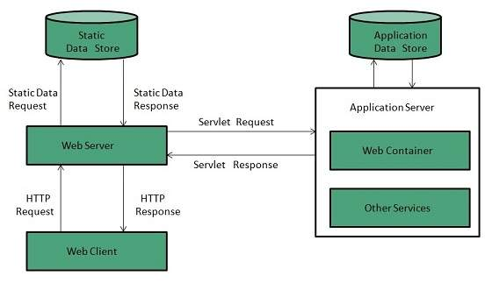
Introduction to Web Servers
Working of Web Server

Slide 10
Introduction to Web Servers
Web server is a computer where the web content is stored. Basically web server is used to host the web sites but there exists other web servers also such as gaming, storage, FTP, email etc.
Web Server Working
Web server respond to the client request in either of the following two ways:
1. Sending the file to the client associated with the requested URL.
2. Generating response by invoking a script and communicating with database

Slide 11
Introduction to Web Servers
Key Points
When client sends request for a web page, the web server search for the requested page if requested page is found then it will send it to client with an HTTP response.
If the requested web page is not found, web server will the send an HTTP response: Error 404 Not found.
If client has requested for some other resources then the web server will contact to the application server and data store to construct the HTTP response.

Slide 12
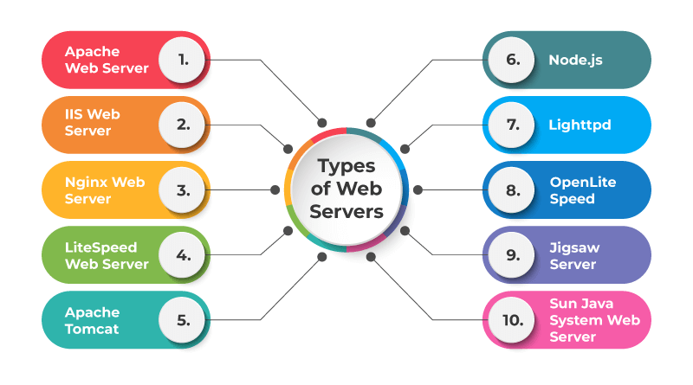
Introduction to Web Servers
List of Popular Web Servers

Slide 13
Introduction to Web Servers
Apache Web Server
Apache web server is one of the most popular web servers developed by the Apache Software Foundation. Open source software, Apache supports almost all operating systems such as Linux, Windows, Unix FreeBSD, Mac OS X and more. Approximately, 60% of the machines run on Apache Web Server.
IIS Web Server
A Microsoft product, IIS is a server that offers all the features such as Apache. Since it’s not an open source, adding personal modules as well as modifying becomes a bit difficult.
It supports all the platforms that run Windows operating system. Additionally, you also get good customer support, if there is any issue.

Slide 14
Introduction to Web Servers
Nginx Web Server
Nginx is the next open source web server after Apache. It comprises of IMAP/POP3 proxy server. The significant features offered by Nginx are high performance, stability, simple configuration and low resource usage.
Apache Tomcat
An open source Java servlet container, Apache Tomcat functions as a web server. A Java program that expands the capabilities of a server is called as a Java servlet.
Sun Java System Web Server
Sun Java System Web Server, which was earlier known as Sun One Web Server and iPlanet Web Server is a multi-threaded and secure Web Server developed by Sun Microsystems. Later, it was taken over by Oracle.

Slide 15
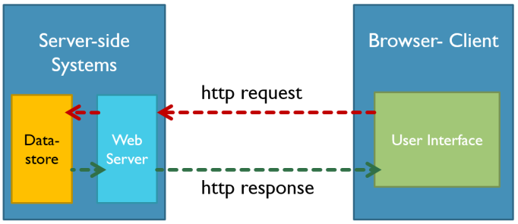
HTTP Request and Response Model

Slide 16
HTTP Request and Response Model
The request-response model defines a communication pattern where a client sends a request to a server, and the server responds with a corresponding response.
1. Client Sends a Request
The client (usually a browser or app) initiates communication.
It sends an HTTP Request to the web server.
Request includes:
Method: What action to perform (e.g., GET, POST)
URL: Address of the resource (e.g., /index.html)
Headers: Additional information (e.g., browser type, language)
Body: (Optional) Data to send (e.g., form data in POST)

Slide 17
HTTP Request and Response Model
2. Server Processes the Request
The server receives the request.
It finds the resource or performs the requested action.
Prepares an HTTP Response to send back.

Slide 18
HTTP Request and Response Model
3. Server Sends a Response
The server sends back a response to the client.
Response includes:
Status code (e.g., 200 OK, 404 Not Found)
Headers (e.g., content type, length)
Body (e.g., HTML page, image, JSON data)

Slide 19
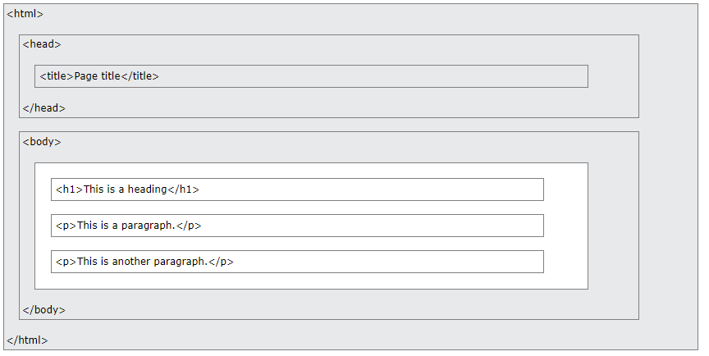
Structure of HTML

Slide 20
Structure of HTML
The <!DOCTYPE html> declaration defines that this document is an HTML5 document.
The <html> element is the root element of an HTML page
The <head> element contains meta information about the HTML page
The <title> element specifies a title for the HTML page (which is shown in the browser's title bar or in the page's tab)
The <body> element defines the document's body, and is a container for all the visible contents, such as headings, paragraphs, images, hyperlinks, tables, lists, etc.
The <h1> element defines a large heading
The <p> element defines a paragraph
<!DOCTYPE html>
<html>
<head>
<title>Page Title</title>
</head>
<body>
<h1>My First Heading</h1>
<p>My first paragraph.</p>
</body>
</html>

Slide 21
Doctypes in HTML
All HTML documents must start with a <!DOCTYPE> declaration.
The declaration is not an HTML tag.
It is an "information" to the browser about what document type to expect.
In HTML 5, the declaration is simple: <!DOCTYPE html>
HTML 4.01: <!DOCTYPE HTML PUBLIC "-//W3C//DTD HTML 4.01 Transitional//EN" "http://www.w3.org/TR/html4/loose.dtd">
The <!DOCTYPE> declaration is NOT case sensitive.
<!DOCTYPE html>
<!DocType html>
<!Doctype html>
<!doctype html>

Slide 22
HTML Elements, tags and attributes
HTML Element :
An HTML element is the basic building block of an HTML document.
It typically consists of a start tag, content (optional), and an end tag.
HTML elements define the structure and content of the webpage, such as paragraphs, headings, images, links, etc.
Example: <p>This is a paragraph.</p>

Slide 23
HTML Elements, tags and attributes
HTML Tags:
HTML tags are used to define the beginning and end of an HTML element.
They are enclosed within angle brackets (<>).
Most elements have both an opening tag and a closing tag. The closing tag includes a forward slash before the element's name (e.g., <p> and </p>).
Some tags are self-closing (empty elements) and do not require a closing tag, such as the <img> tag (for images) or the <br> tag (for line breaks).

Slide 24
HTML Elements, tags and attributes
HTML attributes
Attributes provide additional information or properties about an HTML element.
They are always placed within the opening tag of an element.
Attributes consist of a name-value pair, separated by an equal sign, with the value enclosed in double or single quotes (e.g., href="value").

Slide 25
HTML Elements, tags and attributes
Example of an HTML Element with Tags and Attributes
<a href="https://www.example.com" target="_blank" title="Visit Example.com">Click Here</a>

Slide 26
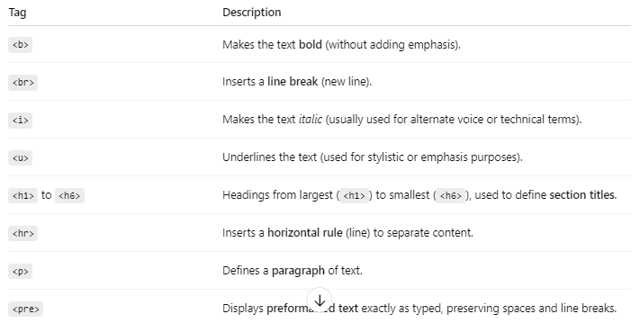
HTML Elements, tags and attributes

Slide 27
HTML Elements, tags and attributes
HTML Attributes
The src Attribute: <img src="img_girl.jpg">
The width and height Attributes : <img src="img_girl.jpg" width="500" height=“500">
The alt Attribute: <img src="img_girl.jpg" alt="Girl with a jacket">
The style Attribute : <p style="color:red">This is a paragraph.</p>
The lang Attribute: <html lang="en-US">
The title Attribute : <p title="I'm a tooltip">

Slide 28
HTML Styles
Setting the style of an HTML element, can be done with the style attribute.
<tagname style="property:value;">
The property is a CSS property. The value is a CSS value.
style attribute: for styling HTML elements
background-color: for background color
color : for text colors
font-family: for text fonts
font-size: for text sizes
text-align: for text alignment

Slide 29
HTML Styles
Background Color
<body style="background-color:powderblue;">
<h1>This is a heading</h1>
<p>This is a paragraph.</p>
</body>
Font family
<h1 style="font-family:verdana;">This is a heading</h1>
<p style="font-family:courier;">This is a paragraph.</p>

Slide 30
HTML Styles
Font color
<h1 style=“color:red;">This is a heading</h1>
<p style="font-family:courier;">This is a paragraph.</p>
Text Size
<h1 style="font-size:300%;">This is a heading</h1>
<p style="font-size:160%;">This is a paragraph.</p>

Slide 31
HTML Styles
Text Alignment:
<h1 style="text-align:center;">Centered Heading</h1>
<p style="text-align:right;">Centered paragraph.</p>
Alignments can be:
Right
Left
Center
Justify

Slide 32
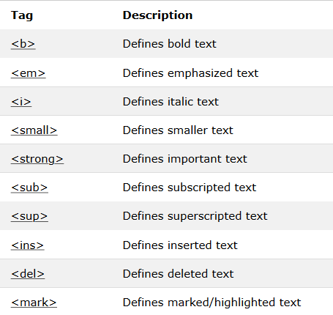
HTML Text Formatting

Slide 33
HTML Text Formatting
<!DOCTYPE html>
<html lang="en">
<head>
<title>HTML Text Formatting Demo</title>
</head>
<body>
<h2>HTML Text Formatting Demo</h2>
<p><b>This is bold text using &lt;b&gt;</b></p>
<p><em>This is emphasized text using &lt;em&gt;</em></p>
<p><i>This is italic text using &lt;i&gt;</i></p>
<p><small>This is smaller text using &lt;small&gt;</small></p>
<p><strong>This is important text using &lt;strong&gt;</strong></p>
<p>This is normal text with <sub>subscript</sub> using &lt;sub&gt;</p>
<p>This is normal text with <sup>superscript</sup> using &lt;sup&gt;</p>
<p>This is <ins>inserted</ins> text using &lt;ins&gt;</p>
<p>This is <del>deleted</del> text using &lt;del&gt;</p>
<p>This is <mark>highlighted</mark> text using &lt;mark&gt;</p>
</body>
</html>

Slide 34
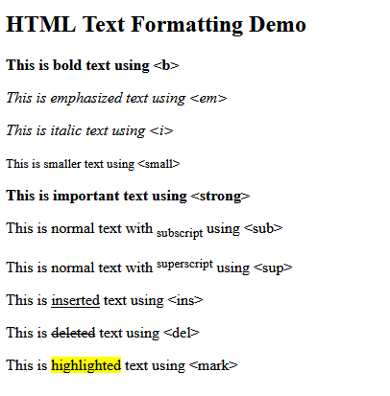
HTML Text Formatting
Output

Slide 35
HTML Link
Links are found in nearly all web pages. Links allow users to click their way from page to page.
HTML links are hyperlinks. You can click on a link and jump to another document.
<a href="url">link text</a>
HTML Links - The target Attribute
The target attribute specifies where to open the linked document.
_blank - Opens the linked document in a new window or tab
_self - Opens the linked document in the same window/tab as it was clicked (this is default)
_parent - Opens the linked document in the parent frame
_top - Opens the linked document in the full body of the window
framename - Opens the linked document in a named frame

Slide 36
List
Using HTML we can form Lists, which can be numbered or just bulleted.
Lists
Unordered list
Ordered List
Nested List
Definition List

Slide 37
List
1. Unordered lists (<ul>)
These are used when the order of items is not important.
List items are typically marked with bullet points by default.
  <ul>
    <li>Milk</li>
    <li>Bread</li>
    <li>Cereal</li>
  </ul>

Slide 38
List
2. Ordered lists (<ol>)
These lists are used when the order of the items is important.
Each item is typically marked with numbers or letters by default.
  <ol>
    <li>First step</li>
    <li>Second step</li>
    <li>Third step</li>
  </ol>

Slide 39
List
3. Description lists (<dl>)
These lists are used to define terms and their corresponding descriptions.
Each list item is composed of a term (<dt>) and its description (<dd>).
  <dl>
    <dt>HTML</dt>
    <dd>HyperText Markup Language</dd>
    <dt>CSS</dt>
    <dd>Cascading Style Sheets</dd>
  </dl>

Slide 40
List
Nesting lists
You can create hierarchical structures by placing one list inside a list item (<li>) of another list.
  <ul>
    <li>Fruits
      <ul>
        <li>Apple</li>
        <li>Banana</li>
      </ul>
    </li>
    <li>Vegetables</li>
  </ul>

Slide 41
HTML Tables
To display data in tabular form, that is area is divided into rows and columns to show association.
An HTML table is defined with the <table> tag.
Each table row is defined with the <tr> tag.
A table header is defined with the <th> tag. By default, table headings are bold and centered.
A table data/cell is defined with the <td> tag.
Note: The <td> elements are the data containers of the table.
They can contain all sorts of HTML elements; text, images, lists, other tables, etc.
Rowspan: To make a cell span more than one row, use the rowpan attribute.
Colspan: To make a cell span more than one column, use the colspan attribute.

Slide 42
HTML Tables
Adding a Caption : To add a caption to a table, use the <caption> tag right after table tag.
<caption>caption for table</caption>
Adding table border: If you do not specify a border for the table, it will be displayed without borders.
A border is set using the CSS border property
<table border=“1px”>
Collapsed Borders : If you want the borders to collapse into one border, add the CSS border-collapse property.
<table border=“1px” style=“border-collapse:collapse”>
Adding Cell Padding : Cell padding specifies the space between the cell content and its borders.
To set the padding, use the CSS padding property or we can specify it in table tag cellpadding property.

Slide 43
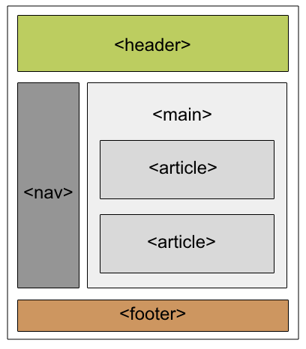
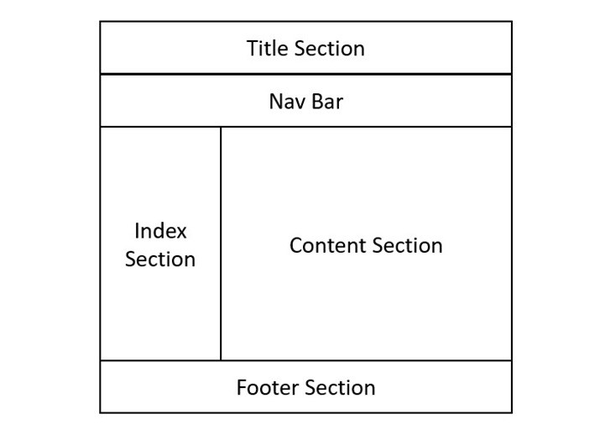
HTML 5 Layout and syntax

Slide 44
HTML 5 Layout and syntax
HTML5 introduced semantic tags specifically designed to improve the structure and layout of webpages, making them more meaningful for both browsers and developers.
<header>: Represents the introductory content or a section of navigational links at the top of a document or a section.
<nav>: Defines a set of navigation links (e.g., the main menu of a website). It's best used for major blocks of navigation.
<section>: Used to group related content together, forming thematic groupings. Each <section> usually has a heading to describe its content.
<article>: Represents independent, self-contained content that can be distributed independently of the rest of the page (e.g., blog posts, news articles).

Slide 45
HTML 5 Layout and syntax
<aside>: Contains content that is indirectly related to the main content, like a sidebar with related links or additional information.
<footer>: Defines the footer of a document or section, typically containing information like authorship, copyright, or related links.
<main>: Specifies the dominant content of the <body> of a document or web application, intended to be unique to that page.
<figure> and <figcaption>: The <figure> tag specifies self-contained content, like images or diagrams, while <figcaption> provides a caption for the <figure>.
<mark>: The <mark> tag in HTML is used to define the marked text. It is used to highlight the part of the text in the paragraph.

Slide 46
HTML 5 Layout and syntax
<audio>: It defines the music or audio content.
<embed>: Defines containers for external applications (usually a video player).
<source>: It defines the sources for <video> and <audio>.
<track>: It defines the tracks for <video> and <audio>.
<video>: It defines the video content.
<time>: The <time> tag is used to display the human-readable data/time. It can also be used to encode dates and times in a machine-readable form. The main advantage for users is that they can offer to add birthday reminders or scheduled events in their calender’s and search engines can produce smarter search results.
<bdi>: The <bdi> tag refers to the Bi-Directional Isolation. It differentiate a text from other text that may be formatted in different direction. This tag is used when a user generated text with an unknown directions.

Slide 47
HTML Events
HTML events are "things" that happen to HTML elements, such as a user clicking on a button or submitting a form, or a page finishing loading.
Types of HTML events
Window Events:
onload
onbeforeunload
onresize
Form Events:
onsubmit
onchange
onfocus
Keyboard Events:
onkeydown, onkeypress and onkeyup

Slide 48
HTML Events
Mouse Events:
onclick
onmouseover
onmousedown
Drag Events:
ondragstart
ondragenter
ondrop
Clipboard Events:
oncopy
oncut
onpaste
Media Events:
onplay
onpause
onended

Slide 49
Audio and Video in HTML
HTML5 makes it easy to embed audio and video directly into your web pages using the <audio> and <video> tags respectively.
1. Adding audio
To include an audio file in your HTML, use the <audio> tag.
<audio controls>
  <source src="audio.mp3" type="audio/mpeg">
  <source src="audio.ogg" type="audio/ogg">
  Your browser does not support the audio element.
</audio>

Slide 50
Audio and Video in HTML
2. Adding video
<video controls width="320" height="240" poster="image.jpg">
<source src="video.mp4" type="video/mp4">
<source src="video.webm" type="video/webm">
Your browser does not support the video element.
</video>

Slide 51
Audio and Video in HTML
3. Embedding YouTube videos
You can embed YouTube videos into your HTML using the <iframe> tag.
Steps:
Go to the YouTube video you want to embed.
Click the "Share" button.
Select the "Embed" option.
Copy the generated HTML code.
Paste the code into your HTML document where you want the video to appear.
<iframe width="560" height="315"
src="https://www.youtube.com/embed/VIDEO_ID?autoplay=1&mute=1"
allow="autoplay; encrypted-media"
frameborder="0" allowfullscreen>
</iframe>

Slide 52
Web Form and Validation
To collect information from user, there is need to generate form.
The <form> Element
HTML <form> element defines a form that is used to collect user input.
<form>
Form elements
</form>
An HTML form contains form elements.
Form elements are different types of input elements, like text fields, checkboxes, radio buttons, submit buttons, and more.

Slide 53
Web Form and Validation
HTML Element | Description
<form action="#"> | Starts a form block
<input type="text" name="username"> | Single-line text input.
<input type="password" name="password"> | Hidden-character input for passwords.
<input type="email" name="email"> | Input for email addresses.
<input type="radio" name="gender" value="male"> | Radio button (choose one).
<input type="checkbox" name="subscribe"> | Checkbox for multiple selections.
<textarea name="message"></textarea> | Multi-line text input area.
<select name="country"> | Dropdown selection menu.
<input type="submit" value="Submit"> | Submit button.
<label for="username">Username:</label> | Label for an input field.

Slide 54
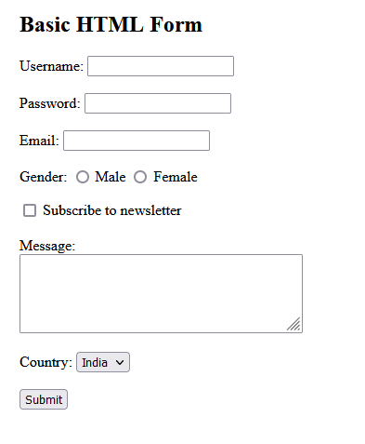
Web Form and Validation

Slide 55
SVG - Scalable Vector Graphics
SVG defines vector-based graphics in XML, which can be directly embedded in HTML pages.
SVG graphics are scalable, and do not lose any quality if they are zoomed or resized.
SVG stands for Scalable Vector Graphics
SVG is used to define vector-based graphics for the Web
SVG defines graphics in XML format
Each element and attribute in SVG files can be animated
SVG is a W3C recommendation

Slide 56
SVG - Scalable Vector Graphics
The <svg> Element
The HTML <svg> element is a container for SVG graphics.
SVG has several methods for drawing paths, rectangles, circles, polygons, text, and much more.

Slide 57

SVG - Scalable Vector Graphics
SVG Circle
<!DOCTYPE html>
<html>
<body>
<svg width="100" height="100">
<circle cx="50" cy="50" r="40" stroke="green" stroke-width="4" fill="yellow" />
</svg>
</body>
</html>

Slide 58
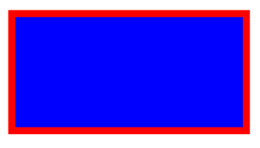
SVG - Scalable Vector Graphics
SVG Rectangle
<svg width="400" height="120">
<rect x="10" y="10" width="200" height="100" stroke="red" stroke-width="6" fill="blue" />
</svg>

Slide 59

SVG - Scalable Vector Graphics
SVG Star
<svg width="300" height="200">
<polygon points="100,10 40,198 190,78 10,78 160,198"
style="fill:lime;stroke:purple;stroke-width:5;fill-rule:evenodd;" />
</svg>

Slide 60

SVG - Scalable Vector Graphics
SVG Gradient Ellipse and Text
<svg height="130" width="500">
<defs>
<linearGradient id="grad1">
<stop offset="0%" stop-color="yellow" />
<stop offset="100%" stop-color="red" />
</linearGradient>
</defs>
<ellipse cx="100" cy="70" rx="85" ry="55" fill="url(#grad1)" />
<text fill="#ffffff" font-size="45" font-family="Verdana" x="50" y="86">SVG</text>
Sorry, your browser does not support inline SVG.
</svg>

Slide 61


